Slide 1
Object Oriented Programming with C++

Slide 2
Why OOP?
Is the latest fashion in computer science.
OOP is so cool, that some people want to re-write all programs and operating systems using an OOP language, say C++ for example.
Everyone from this school of thought is talking about OOP but. . . does anybody really know what it all exactly means?

Slide 3

History of Programming
Early computers in 1970s - Expensive but with limited abilities.
Goal of Programmers was to maximise precious hardware resources.
The code was fit into the small amount of available core memory, where each bit was hand wired.
Disk space was around 5 Mbyte and it had to keep also an operating
system.
Program should have used the central processor of the computer very carefully, so each piece of code was written to minimise CPU time as well.
Programs were written in Assembler for hardware specific tasks, while scientific computing were done by using FORTRAN.

Slide 4
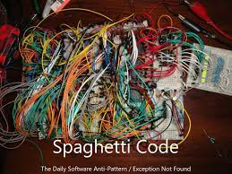
History Of Programming
But with increase in computing power, and drop in the prices of hardware resources, a software crisis arised.
Writing large programs without thinking of modularisation and structuring was simply not feasible.
“Spaghetti programming”, the path a program would take which resembled a pot of spaghetti, was the result.

Slide 5
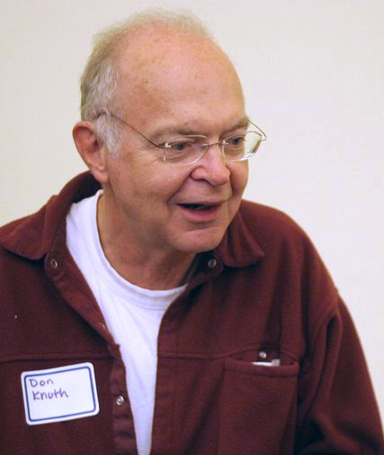
Structured Programming
Donald Knuth, a super programmer estimated mean quantity of “GOTO” statements FORTRAN programs, which was about 13%, which as banned.
PASCAL, a new programming language was implemented
Each program was subdivided into blocks with one entry and one exit: functions, procedures but also if-then-else clauses, for, repeat-until and do-while loops.

Slide 6
Structured Programming
Functional entities needed to be identified and the problems to solve were subdivided into functions and procedures, where each subroutine implemented one of these functional units.
Each subroutine had a well defined interface, i.e. (parameters to be passed of a given type)
To run a Program (written in FORTRAN or PASCAL) a translator was used to produce machine-dependent code of a target computer, so the resulted binary code would only run on the single type of machine and unfortunately incompatible between compilers.
Derived on PASCAL, and B, a new programming language “C” was created, which changed the way programs were written.

Slide 7
Modern problem with computing
However, as programing was being done in C, it could not handle one of the fundamental problem in programming.
The code written in C, was decopuled, because, there was no grouping or relation between the variables and functions, which did operations on them.
Such code was becoming unmanageable to read and also to customize.
In order to overcome this problem, C++ WAS created.

Slide 8
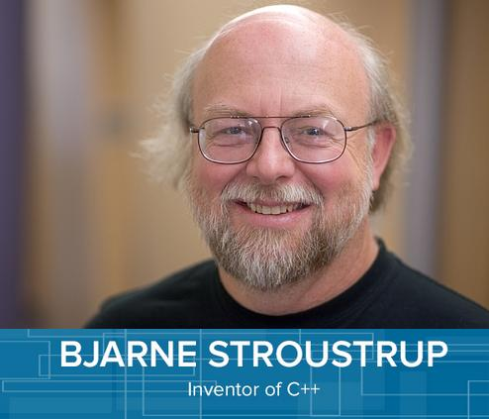
Object oriented programming with
C++
C++, an extension of C, was developed by Bjarne Stroustrup in 1979 at Bell Laboratories.
Originally called “C with Classes”, it was renamed to C++ in the early 1980s.
C++ provides a number of features that “spruce up” the C language, but more importantly, it provides capabilities for object-oriented programming.
C++ programs consist of pieces called classes and functions. You can program each piece yourself, but most C++ programmers take advantage of the rich collections of classes and functions in the C++ Standard Library.

Slide 9
Class
Class: It’s the blueprint, an idea, a definition.
Class is a blueprint, but does not describe anything.
It’s a well defined idea.
A restaurant review website can be defined as a class
GUI Components can be defined as a class
Invisible things like Date, TimeZone, VideoPlayer can be defined as class

Slide 10
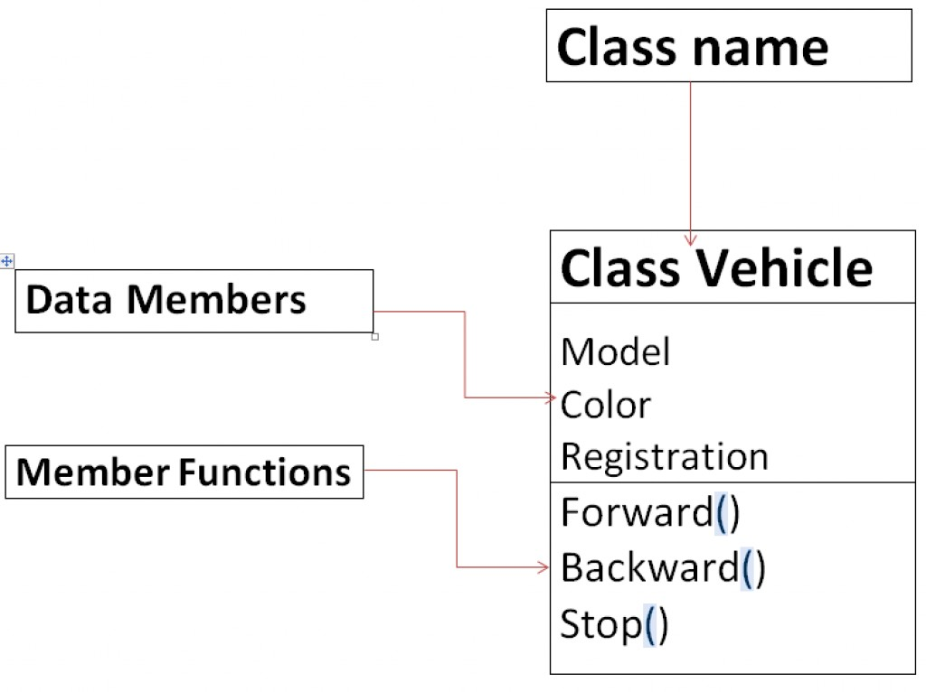
What does a Class Define?
Class consists of Two Parts: Attributes and Behavior
Attributes are the variables or the data components
Behavior - What can we do or how to operate.
Class describes these things in abstract, e.g. it says that a person has a name, & height, but it actually does not define name or height.

Slide 11
Object
An instance of a class
Object-oriented programming shifts the focus of attention to the objects, that is, to the aspects on which the problem is centered
A program designed to maintain bank accounts would work with data such as balances, credit limits, transfers, interest calculations, etc.
An object representing an account in a program will have properties and capacities that are important for account management.

Slide 12
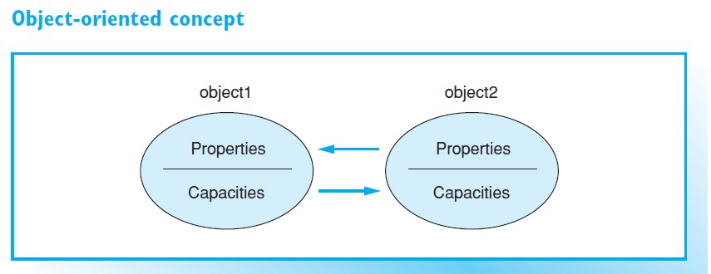
Objects (continued)
Combines data and functions.
Class defines certain type of object by defining properties and methods of the Objects of that type
Objects communicate with each other by passing “messages”, which in turn, activates another object’s methods.

Slide 13
Advantages of OOP
Object-oriented programming offers several major advantages to software development:
Reduced susceptibility to errors: an object controls access to its own data. More specifically, an object can reject erroneous access attempts
Easy re-use: objects maintain themselves and can therefore be used as building blocks for other programs
Low maintenance requirement: an object type can modify its own internal data representation without requiring changes to the application.

Slide 14
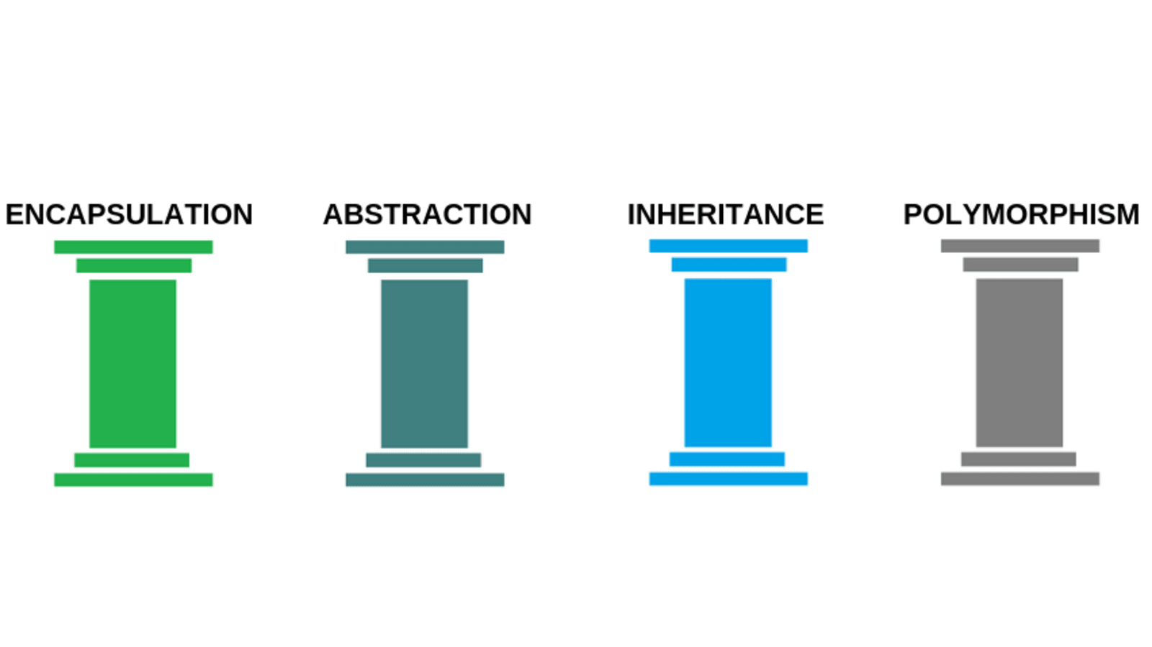
Four Pillars of OOP

Slide 15
Encapsulation
Combine both data and functions that operate on that particular data under a single unit
Classes encapsulate (i.e., wrap) attributes and member functions into objects—an object’s attributes and member functions are intimately related.
Objects may communicate with one another, but they’re normally not allowed to know how other objects are implemented— implementation details are hidden within the objects themselves.

Slide 16
Encapsulation in C++ - Definition Schema
class Demo
{
private:
// Private data members and methods here
public:
// Public data members and methods here
};

Slide 17
Abstraction
Process of only showing the necessary details to the user and hiding the other details in the background.
Control and data are the two types of abstraction in C++.
Abstraction in C++ is achieved through classes, header files, and access specifiers (public, private, protected).

Slide 18
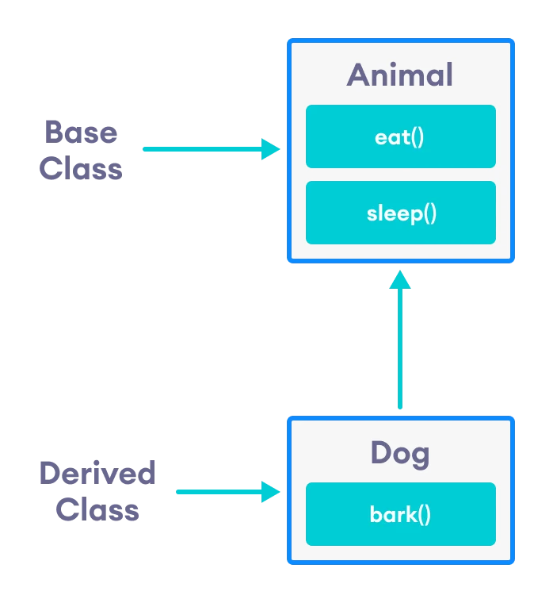
Inheritance
A mechanism to eliminate redundant code.
Allows new classes to be constructed on the basis of existing classes.
Derived class “inherits” the data and methods of the so-called base class. But you can add more characteristics and functionality to the new class.

Slide 19
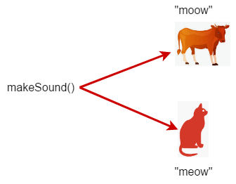
Polymorphism
Derived from Greek Word Poly and morphi, which means, many forms.
Polymorphism is a mechanism in which the same function, name, and operator can be used to operate on different input parameters.
Real life example of Polymorphism is a Person. Person can be a player, an employee and a father at the same time.

Slide 20
Your First C++ Program
#include <iostream>
using namespace std;
int main()
{
cout << "Enjoy yourself with C++!" << endl;
return 0;
}

